Slide 1
Chapter 9
— 例题与作业

Slide 2
例题与作业
例1 最佳页面尺寸
访问时间
例2，例3
例4 缺页中断次数
页置换
例5 两进程局部页置换
考虑缺页中断/页置换的访问时间及逻辑地址-物理地址变换
例6，例7，例8
例9 内核空间分配的伙伴算法
作业：
9.5，9.14
补充作业1，2，3

Slide 3
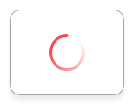
例1 最佳页面尺寸
假定
L: 进程平均长度，单位：字节，e.g. 100M；
p: 以字节为单位的页面长度，且有L>>p，e.g. 1024K；
e: 页表中1个页表项需要占用的字节数，e.g. 4 bytes
求最佳页面尺寸p
进程的页表长度为L/p，占用了(L/p)*e个字节的内存空间
进程最后一页内可能产生内部碎片，碎片浪费的主存平均p/2字节
对一个进程而言，内存空间管理成本
COST = 页表占用的内存空间 + 页内的内部碎片
= (L/p)*e + p/2

Slide 4
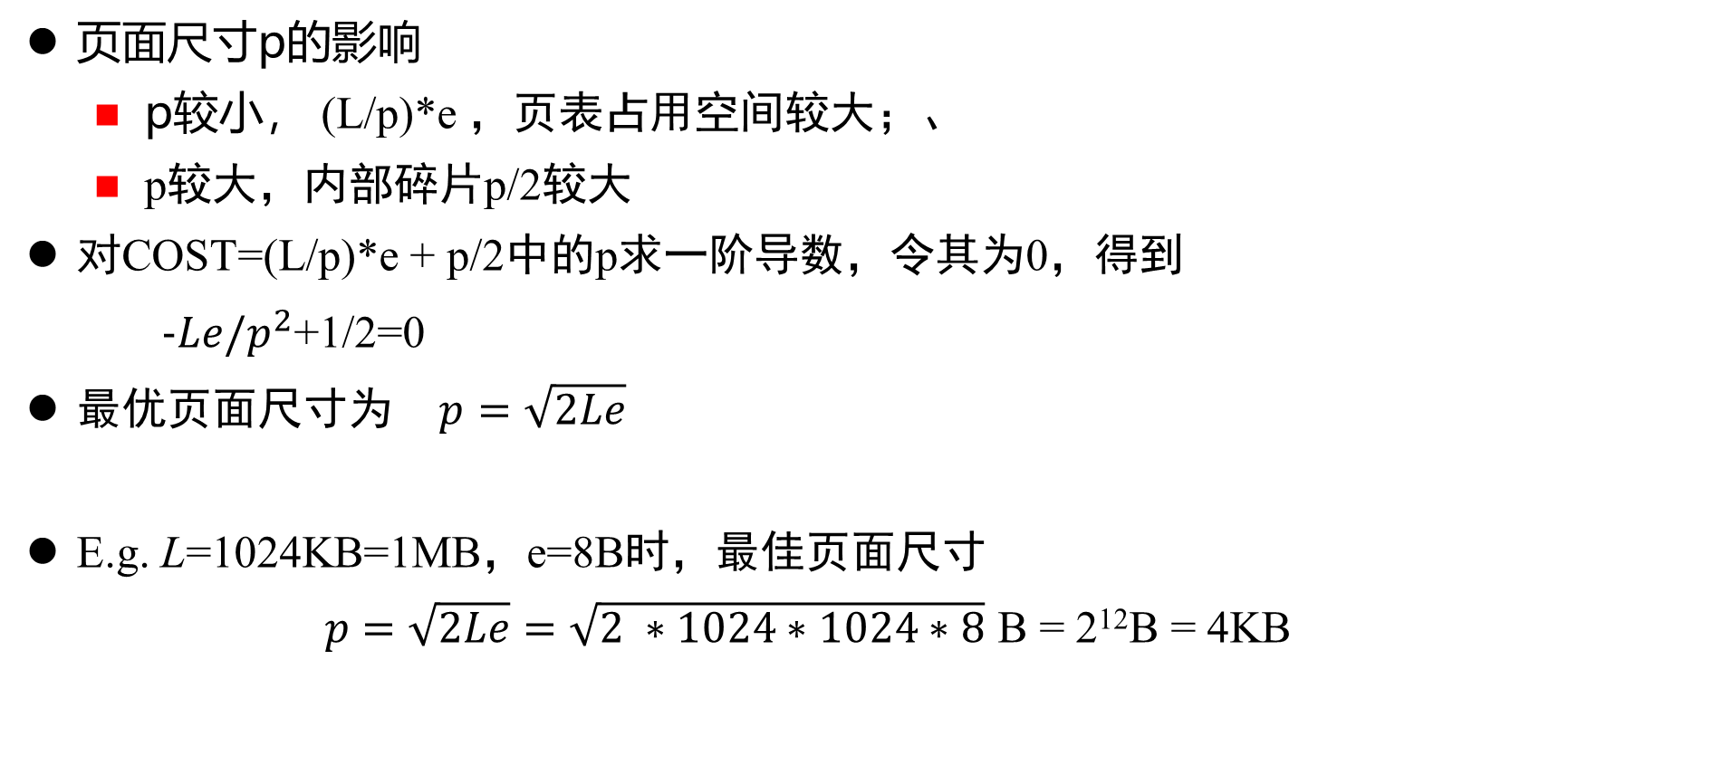
例1 最佳页面尺寸
页面尺寸p的影响
p较小， (L/p)*e ，页表占用空间较大；、
p较大，内部碎片p/2较大
对COST=(L/p)*e + p/2中的p求一阶导数，令其为0，得到
$−Le/p^{2}$+1/2=0
最优页面尺寸为 $p=\sqrt{2Le}$
E.g. L=1024KB=1MB，e=8B时，最佳页面尺寸
$p=\sqrt{2Le}=\sqrt{2 ∗1024∗1024∗8}$ B = 2¹²B = 4KB

Slide 5
例2 EAT
On a system using demand-paging memory
it takes 200*10⁻⁶ ms to satisfy a memory request if the page is in memory
if the page is not in memory, the request takes 7ms if a free frame is available or the page to be swapped out has not been modified，that is, page replacement is not needed
it takes 15ms if the page to be swapped out has been modified, that is, page replacement occurs
What is the effective access time EAT, if the page fault rate is 5%, and 60% of the time the page to be replaced has been modified?

Slide 6
例2
page 在内存中，无page fault, 200*10⁻⁶ ms
0.95
0.4
7ms
有free frame,
或：无free frame但不需swap out
0.05
page 不在内存中
，发生page fault
0.6
无free frame
page replacement
，需要swap out
, 15ms

Slide 7
例2 EAT
The percentage of accesses satisfied in 200ns is 95%，of the 5% of accesses that result in a page fault, 40% require 7ms
Thus, 5% × 40% = 2% of all accesses take 7ms, 5% × 60% = 3% of all accesses take 15ms
So the effective access time is
0.95 ×0.2 + 0.02 × 7000 + 0.03 × 15000 = 0.59019 ms

Slide 8
例3 缺页中断EAT
Consider a paging system with the page table stored in memory
a. if a memory reference takes 300 time unit, how long does it take to access an instruction or data in a page that has been paged into memory?—无缺页中断
b. if we add TLB (translation look-aside buffers), and 80 percent of all page-table entries can be found in the TLB
assume that finding a page-table entry in the associative registers takes 20 time unit, if the entry is there
What is the effective memory access time?

Slide 9
例3 缺页中断EAT
Answers
a. 300 + 300 = 300 * 2 =600
b.
0.8 * (20 + 300) +
0.2 * (20 + 300 + 300) = 256 + 124 =380
successful
access the page table
fetch instruction/data from memory
successful
fetch instruction/data from memory
access TLB
fetch instruction/data from memory
failed
access page table
access TLB

Slide 10
例4 缺页中断次数
A process has access to m frames, initially all empty
分配给进程的物理空间大小为m ，初始为空
If the process makes p memory accesses to n distinct pages, what is the minimum number of page faults that will occur? The maximum?

Slide 11
例4 缺页中断次数
The maximum number of page faults occurs if each reference results in a page fault or p times
This can occur only when m is less than n. However, if the reference pattern occurs such that the next page referenced is the page previously replaced, each reference will cause a fault
Note:
如果物理frame数m≧n，则只需n次中断即可，即将所有需要装入的页全部装入即可，所以缺页中断的下限是n
如果m=1，则每次都会产生一次中断，又因为至多产生p次中断，所以缺页中断的上限是p

Slide 12
例4 缺页中断次数
The minimum number of page faults occurs if each of the n distinct pages is swapped in only once or n times
最小缺页次数为n，每个不同的页都需通过缺页中断至少调入一次
This is possible, for example, if m is greater than or equal to n
Even if m is less than n, the number of swaps may be limited to n. This occurs when there are subsets of the n pages such that no page exists in more than one subset, each subset contains at most m pages, and all references to pages in each subset occur contiguously. (First, pages only in the first subset are referenced, then the second, etc.)

Slide 13
例5 两进程局部页置换
(12 points) In a demand-paging system with 1024-byte page size, two process P₁ and P₂ have the logical spaces of 5 and 6 pages respectively. The main memory is 8 frames in size, in which frame 0 and frame 1 are dedicated to OS, frame 2, frame 3 and frame 4 are allocated to P₁, and frame 5, frame 6 and frame 7 are assigned to P₂.
When P₁ and P₂ are scheduled by round-robin (RR) scheme and concurrently run on a single-core CPU, they alternatively and sequentially access the logical addresses in their own logical spaces, and the logical address reference string is given below:
P₁:860, P₂:870, P₁:1240, P₂:1500, P₁:2300, P₂:2200, P₁:3000, P₂:870,
P₁:4200, P₂:4100, P₁:900, P₂:1300
, here, “P₁:860, P₂:870” means that P₁ references logical address 860 (assuming in decimal values) in its own logical space, and then P₂ accesses logical address 870 in its own logical space.

Slide 14
例5 两进程局部页置换
It is assumed that,
initially, no pages of P₁ and P₂ are loaded into main memory, and only OS resides in memory;
OS takes the local page replacement strategy, that is, a process can take a replacement/swapped-out frame from only its own allocated frames;
OS uses FIFO replacement for P₁ and LRU replacement for P₂, respectively, to select swapped-out pages;
When there are several free frames available, OS allocates the frame with the minimum frame number to the swapped-in page.

Slide 15
例5 两进程局部页置换
Consider the mentioned-above logical address reference string, and answer the following questions
Analyze the page reference string for this reference string, and illustrate by a figure the page replacement procedure during P₁ and P₂ execution
How many page faults occur for P₁ and P₂?
For P₂’s last reference “P₂:1300” in the string, what is the actual physical address that P₂ accesses, and why?

Slide 16
例5 两进程局部页置换
首先，根据进程P1和 P2的执行时访问的logical address和page size，计算这些逻辑地址对应的页号，从而将上述P1 和 P2的logical address reference string转换为page reference string，e.g.
对“P₁:860”，进程P₁访问位于第0页的逻辑地址860=0*1024+860
“P₂:1500”表示进程P₂访问位于第1页的逻辑地址1500=1*1024+476；
转换后的得到的page reference string为：
P₁:0, P₂:0, P₁:1, P₂:1, P₁:2, P₂:2, P₁:3, P₂:0, P₁:4, P₂:4, P₁:0, P₂:1

Slide 17
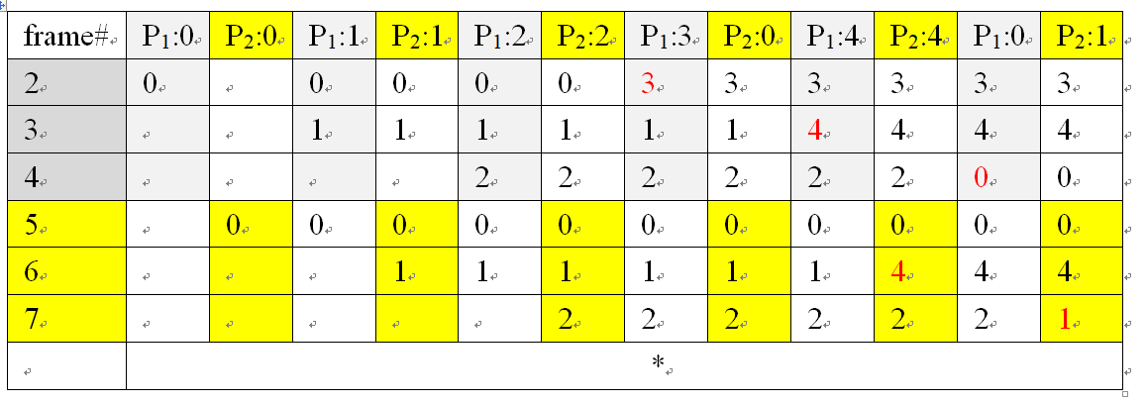
例5 两进程局部页置换

Slide 18
例5 两进程局部页置换
2. 根据上图可知，P1执行过程中发生3次缺页中断，P2执行过程中发生2次缺页中断，总共发生5次缺页中断
3. P₂访问的逻辑地址1300=1*1024 + 276，该地址的页号为1，页内偏移为276。根据上图可知，P₂的page 1被安排在frame 7中，frame 7在物理内存中的首地址为7*1024，因此逻辑地址1300对应的物理地址为7*1024 + 276 =7444

Slide 19
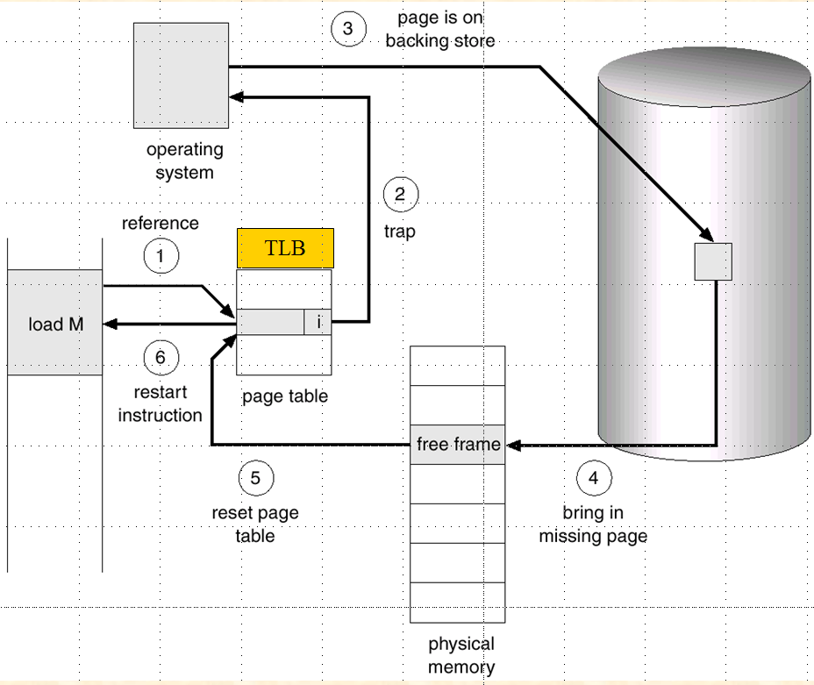
例6 缺页中断/页置换与地址变换
给定某进程中的1个逻辑地址M，计算M对应的物理地址、访问M所需时间。
访问m所在的page经历如下步骤：
访问页表/TLB，地址变换，得到page number、offset
根据page number访问对应的frame，有可能缺页中断
在缺页中断中，加载page number的page，可能需要页置换，采用局部、全局置换策略、/FIFO/OPT页置换算法
页置换完成后，m所在的page被调入内存中某个frame N，根据N的物理地址计算m所对应的物理地址
Fig. 9.6 Steps in handling a page fault

Slide 20
例6 缺页中断/页置换与地址变换

Slide 21
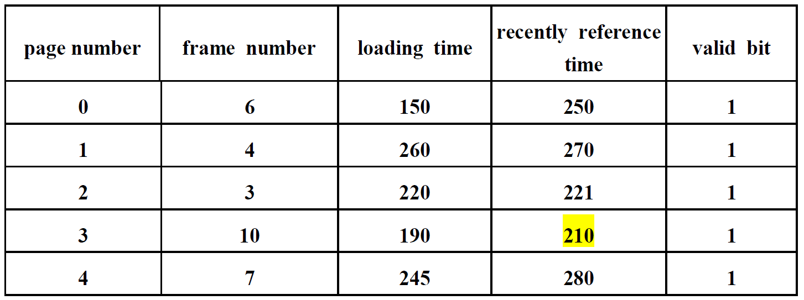
例7 缺页中断/页置换与地址变换

Slide 22
例8 缺页中断/页置换与地址变换-访问时间

Slide 23
例9 内核空间分配的伙伴算法
For a kernel space with the size of 1M= 2²⁰ bytes, there are 21 segments splited by the buddy system, and these segments can be of the size 2⁰, 2¹, …, 2¹⁹, 2²⁰ respectively

Slide 24
申请— A: 70K; B: 35K; C: 80K; D: 60K
0
128K
256K
384K
512K
640K
768K
896K
1M
holes
数目
初始
状态
A | 128 |  | 256 |  | 512
A | B | 64 | 256 |  | 512
A | B | 64 | C | 128 | 512
128 | B | 64 | C | 128 | 512
128 | B | D | C | 128 | 512
128 | 64 | D | C | 128 | 512
256 |  |  | C | 128 | 512
1024
1
3
3
3
4
3
4
3
1
申请70
申请35
申请80
回收A
申请60
回收B
回收D
回收C
内核空间分布

Slide 25
补充作业1 并发进程局部页置换
给出
（1）各个进程的逻辑地址空间组成（#page集合），物理内存空间frames数；
（2）多个进程并发访问时的reference string string，每个page对应的进程已知，即每次reference是由哪个进程发起的是已知的
E.g. 单CPU上，进程A、B并发执行，OS为这2个进程各分配2个frame，reference string为：
1(A), 2(B), 3(A), 4(A), 1(B), 2(A), 5(B), 3(B),1(A), 2(B), 3(A),
4(B), 5(A), 2(A), 4(B), 5(B), 6(A), 4(A), 5(B)
画出采用
（1）LRU+ local replacement
（2）FIFO+ local replacement
时的页置换过程，并计算缺页中断率
（要点：每个进程页置换时，替换自身逻辑空间中的页！）

Slide 26
补充作业2
例8 缺页中断/页置换与地址变换-访问时间

Slide 27
补充作业3 Buddy算法
For a kernel space with the size of 1M= 2²⁰ bytes, 操作系统采用伙伴算法，按照下列顺序依次申请释放一定大小的空间
申请 A: 50K;
申请B: 65K;
申请C: 60K;
释放B；
申请D: 130K
释放C；
释放A；
释放D
参照讲义PPT，画出上述申请-算法过程中，内核空间存储（空闲）分布变化图

